Slide 1
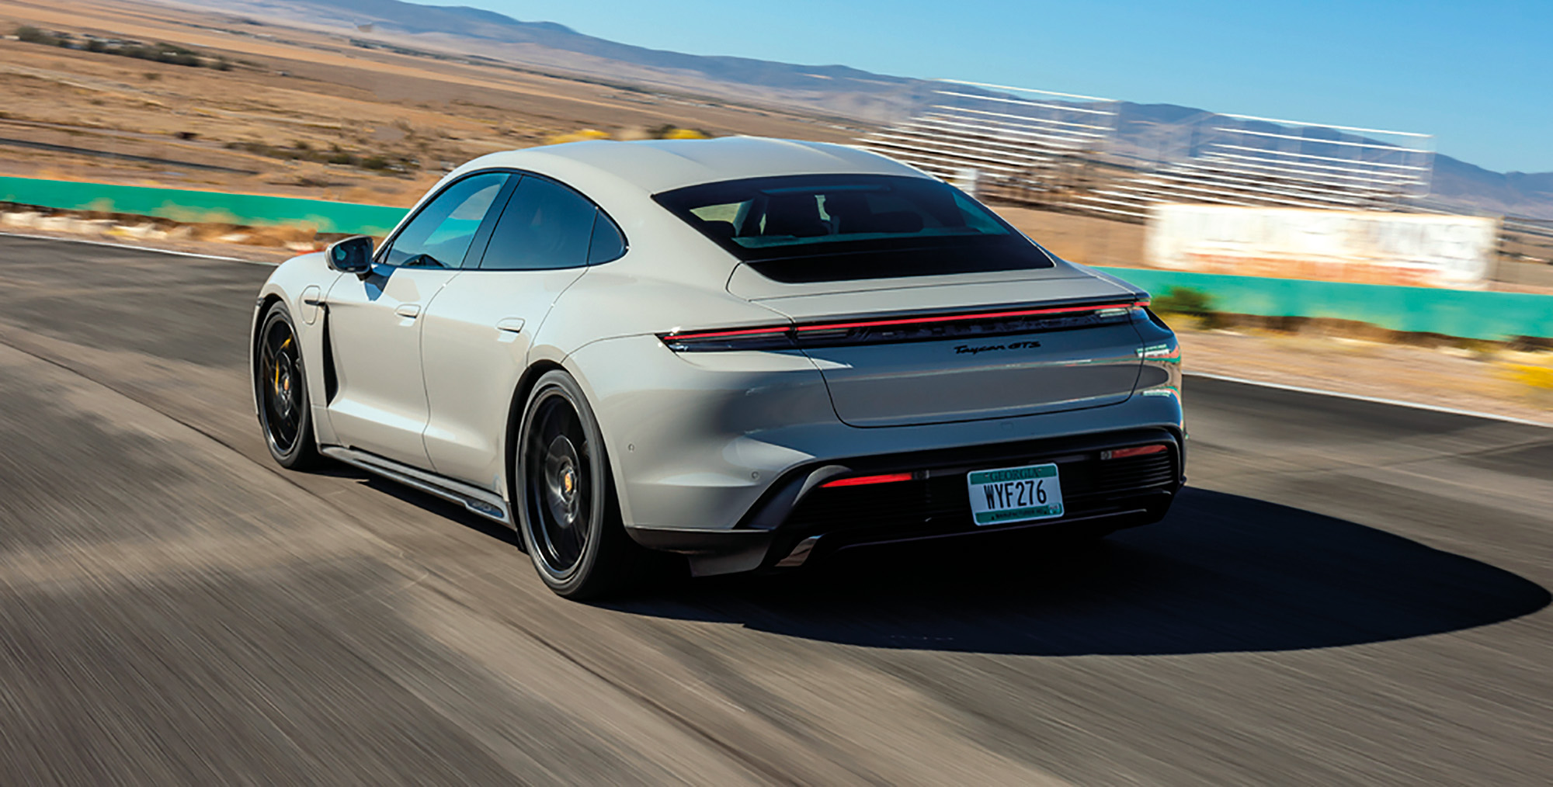
Car price prediction
: Linear Algebra for Data Science

Slide 2
Team member
ณัฐวิทย์ จันทร์เจริญ 65056035 พรรษมน มะโนมัย 65056065 ศุภวิชญ์ รุจิเมธาภาส 65056086 ภัทรพล พูนสมบัติ 65056069

Slide 3


Source Code
https://github.com/natthawit-jan/car_price_prediction_proj

Slide 4
Data
An automobile company wants to predict the car price that the customers are willing to pay for a new car.
Given a few customer features such as age, annual salary and net worth, we can build a linear regression model to predict the expected car price.
Data Source: https://www.kaggle.com/datasets/dev0914sharma/car-purchasing-model

Slide 5
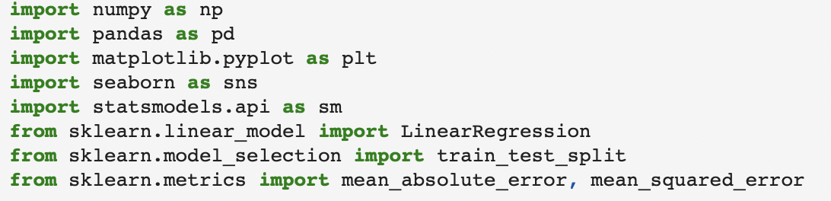
Import Library

Slide 6
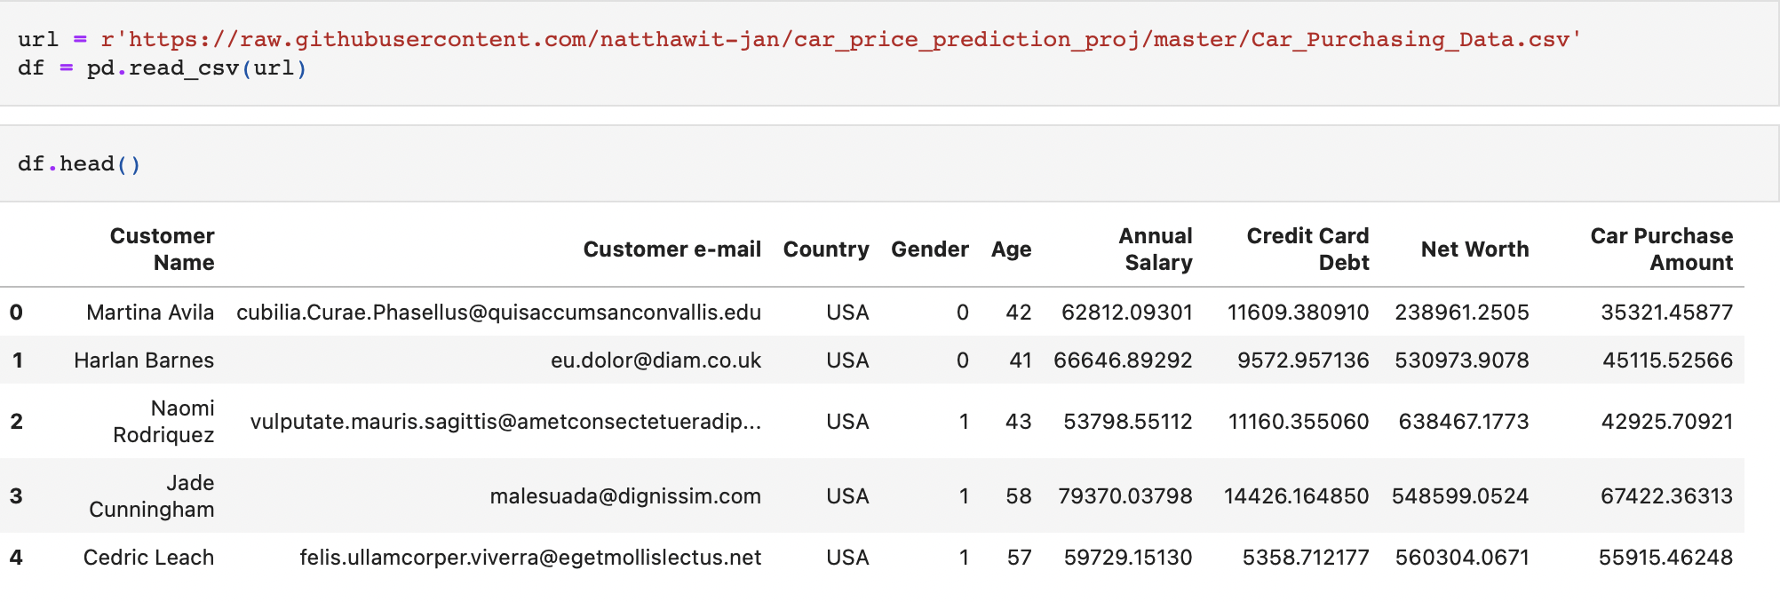
Import Data

Slide 7
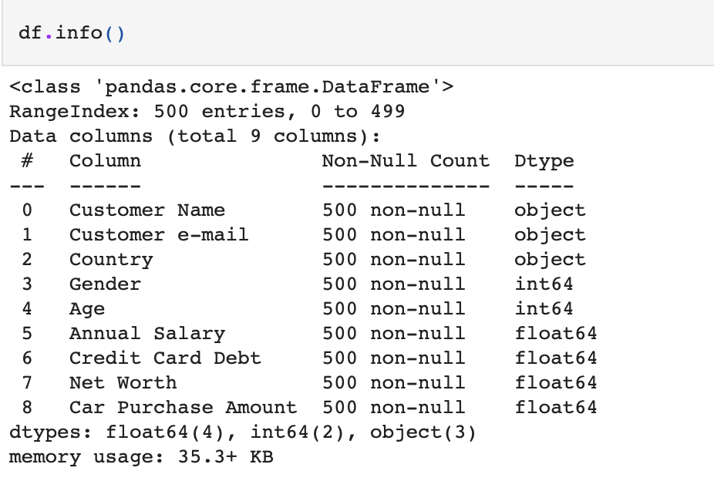
Check Data Missing

Slide 8
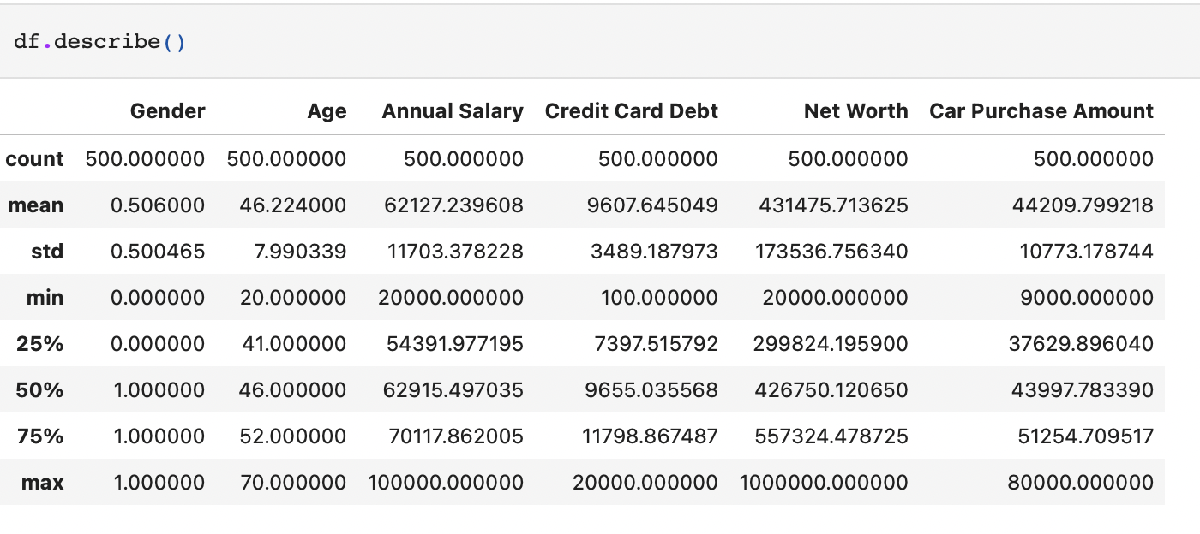
Exploratory Data Analysis
(EDA)

Slide 9
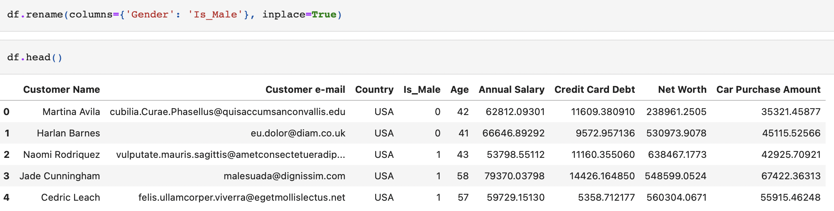
Data Preparation
Rename the column of gender to is_male, where 1 indicates male and female otherwise

Slide 10
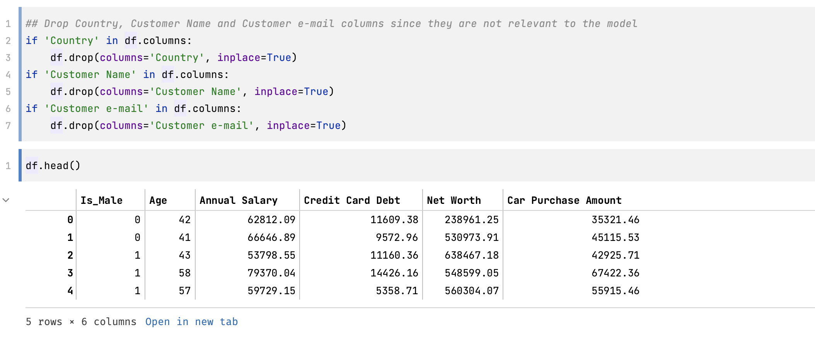
Data Preparation (remove columns)
Drop Country, Customer Name and Customer e-mail columns

Slide 11
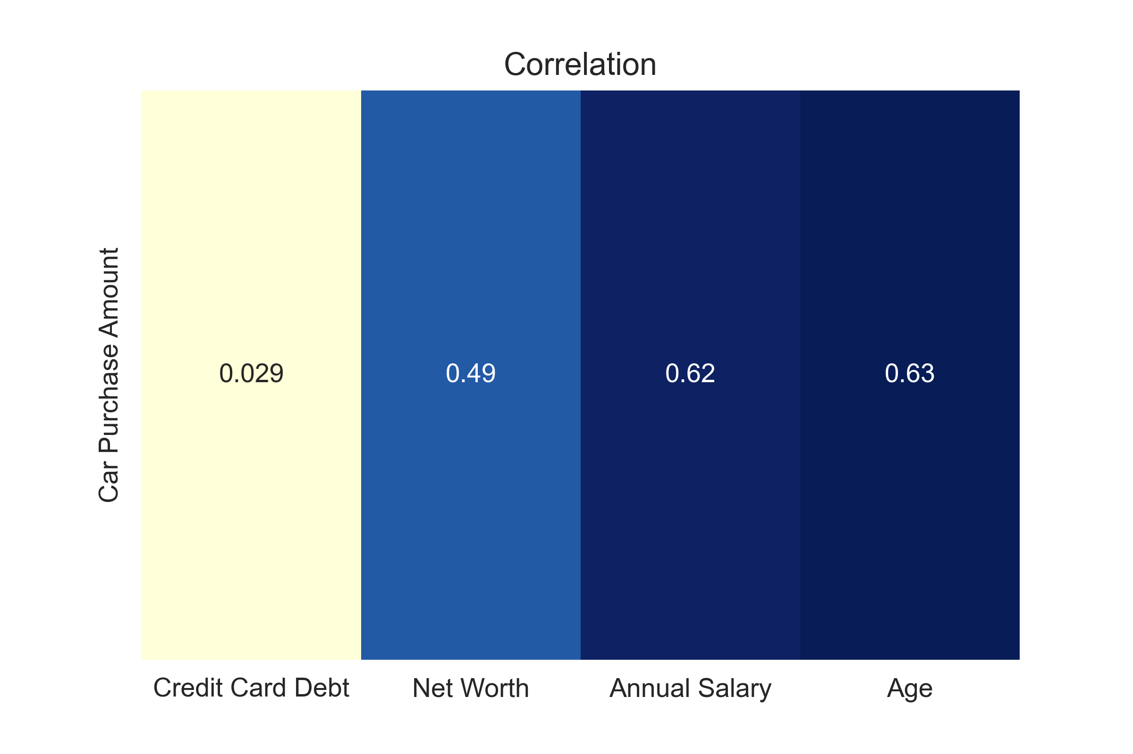
Correlation Heat Map

Slide 12
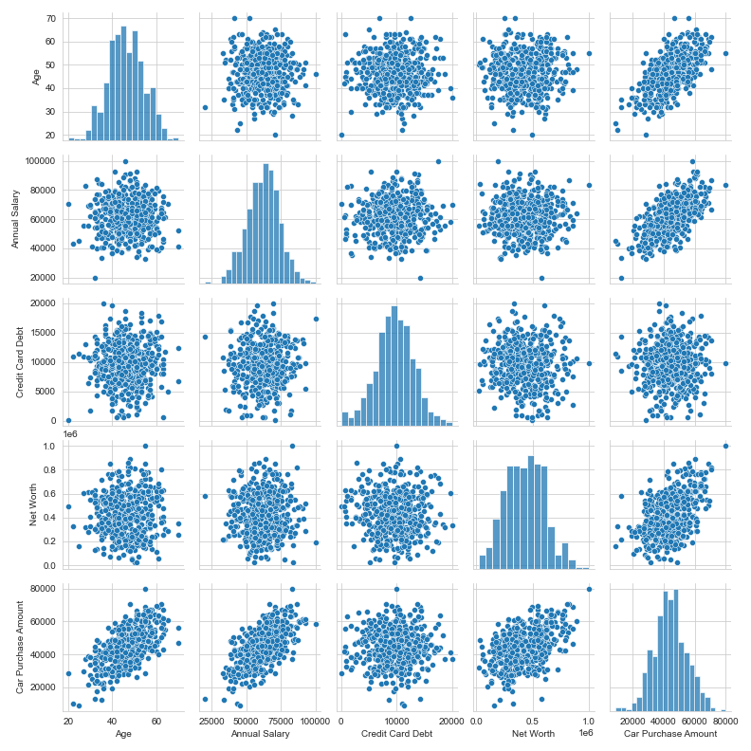
Finding Correlation
between X and Y

Slide 13
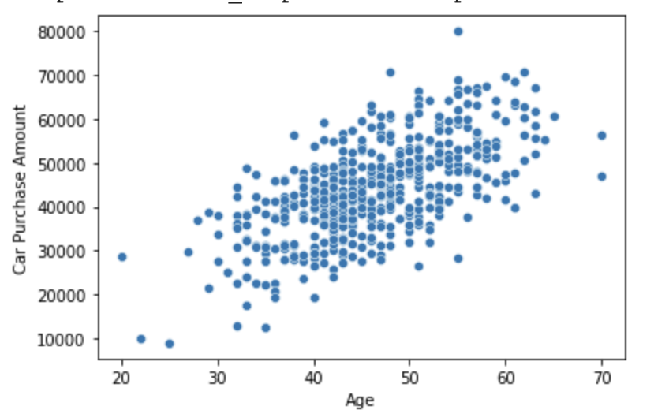
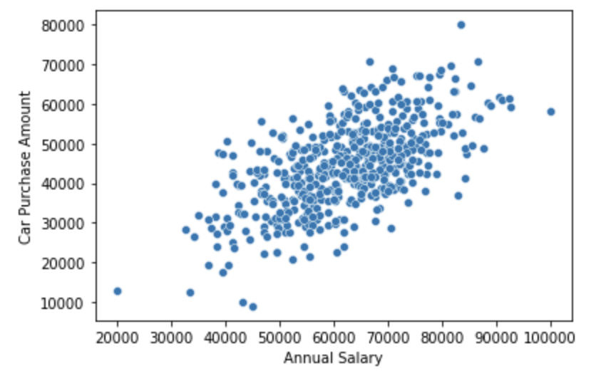
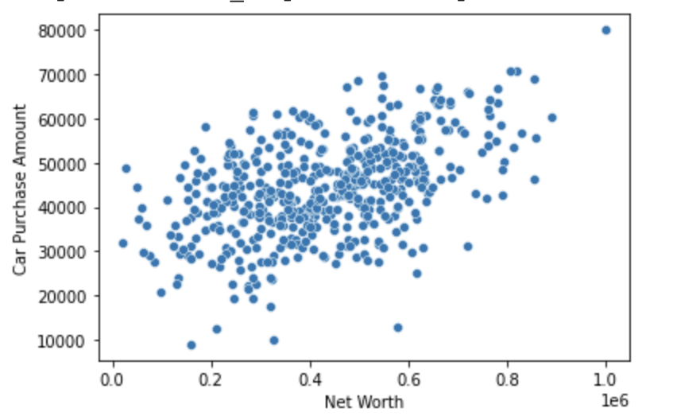
Correlation of 3 linear features

Slide 14
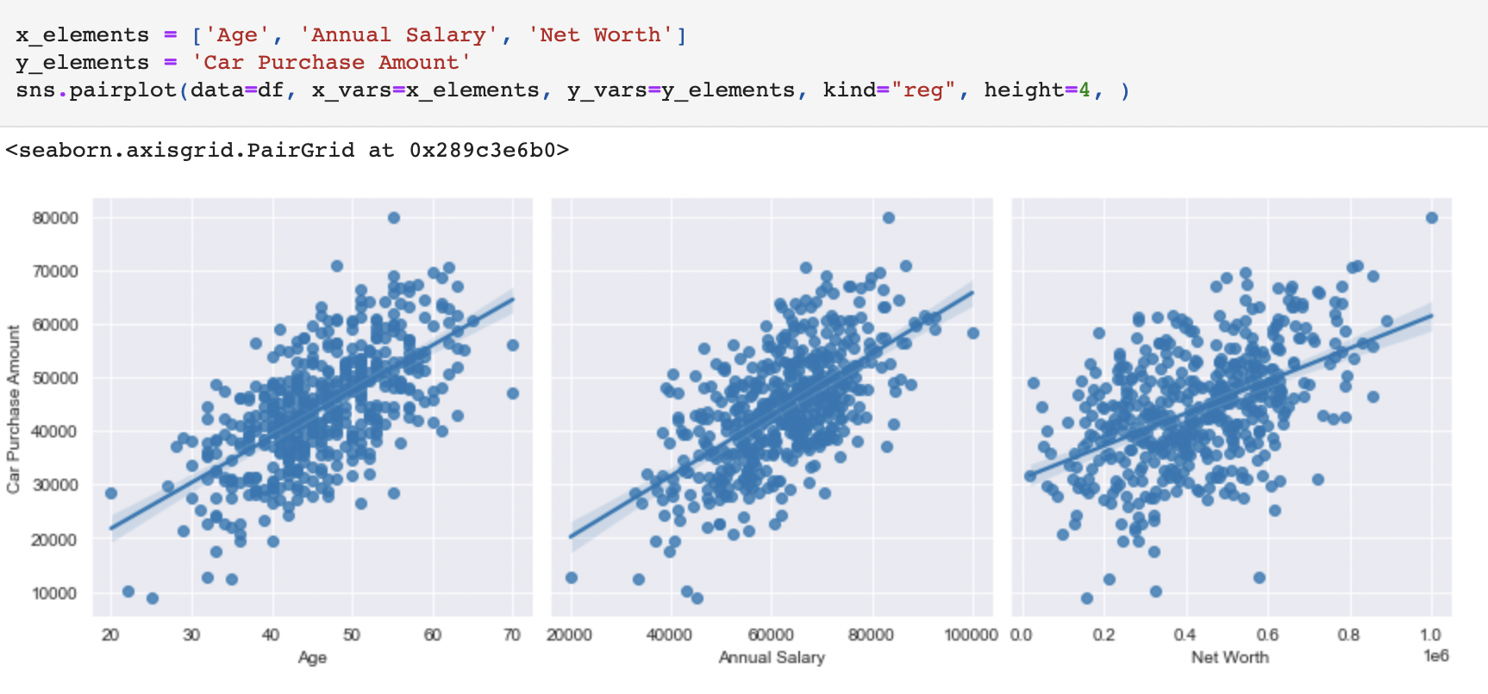
Regression plots for 3 linear features
Therefore, looking from the plots, we can see that there are mainly 3 features that look linear and can be used to train the model. Age, Net Worth and Annual Salary.

Slide 15
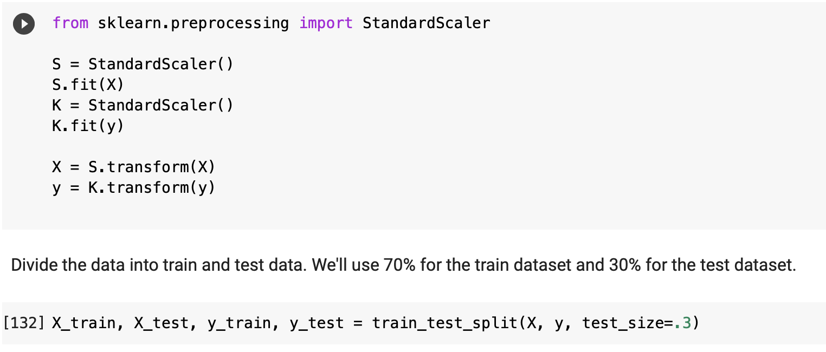
Standardize and Split Data
We standardize the data so that they are centered around the mean of 0 and have the variance of 1
The reason why we did this is that we want to compare the coefficients of each feature obtained from the model summary.

Slide 16
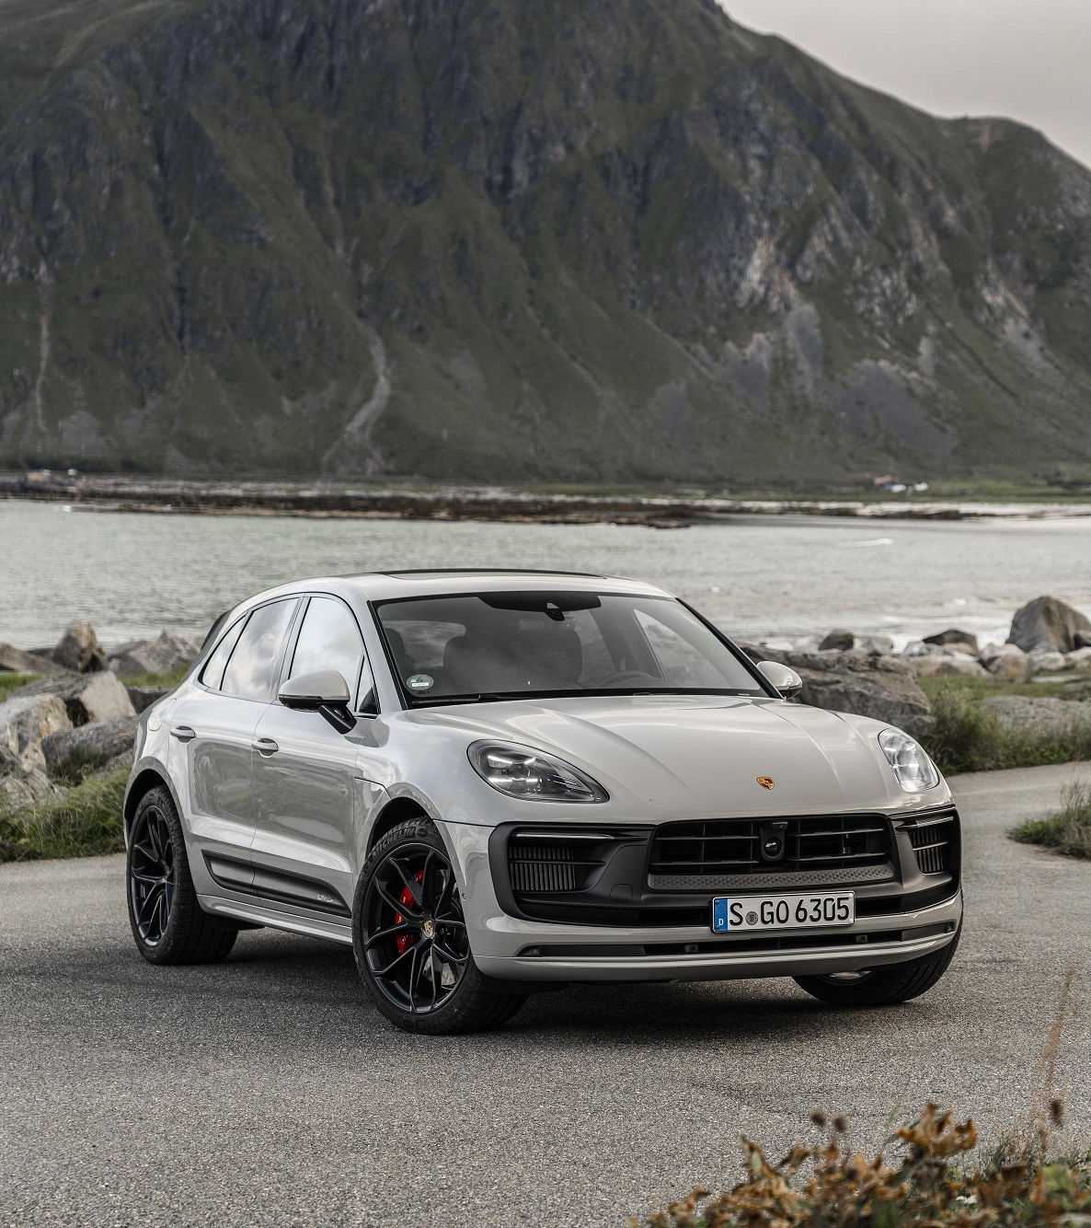
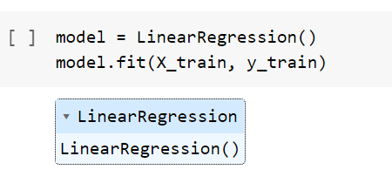
Import Linear Regression model + train data

Slide 17
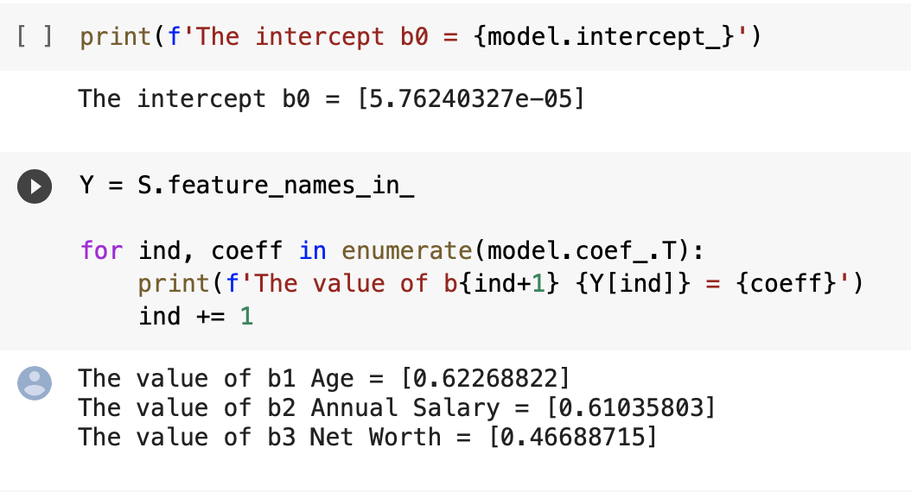
Get all coefficients from the trained model

Slide 18
The regression equation
If `Age` goes up by 1 unit, the car price will also go up by 0.62
If `Annual Salary` goes up by 1 unit, the car price will also go up by 0.61
If `Net worth` goes up by 1 unit, the car price will also go up by 0.47

Slide 19
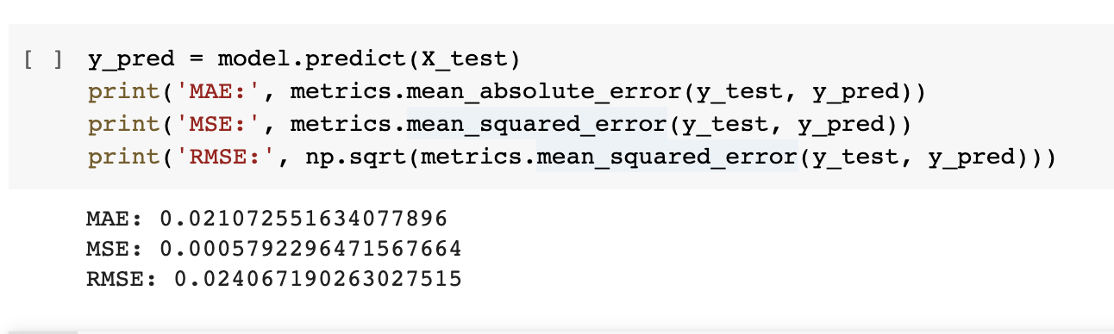
Predict the outcome with test data + Calculate error

Slide 20
From the RMSE result, our model in general can be wrong by 0.024 (std.) ( around 44,000 dollars off )

Slide 21
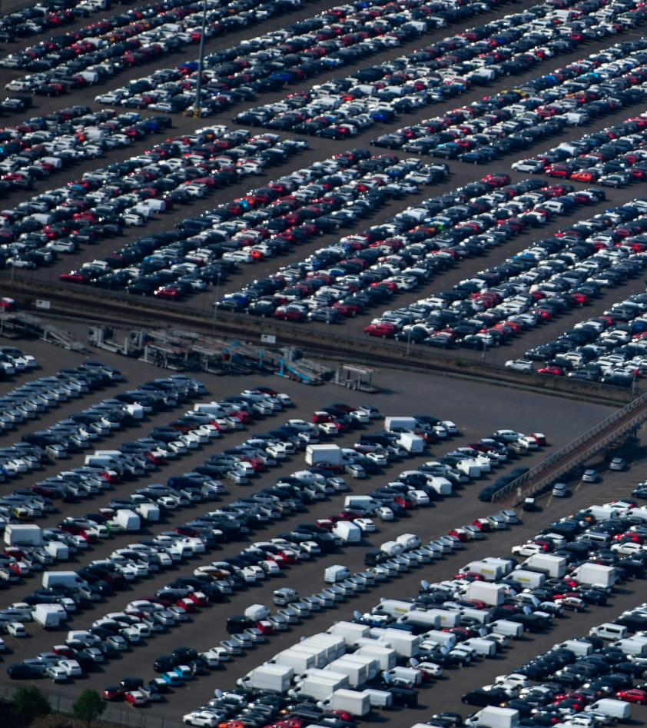
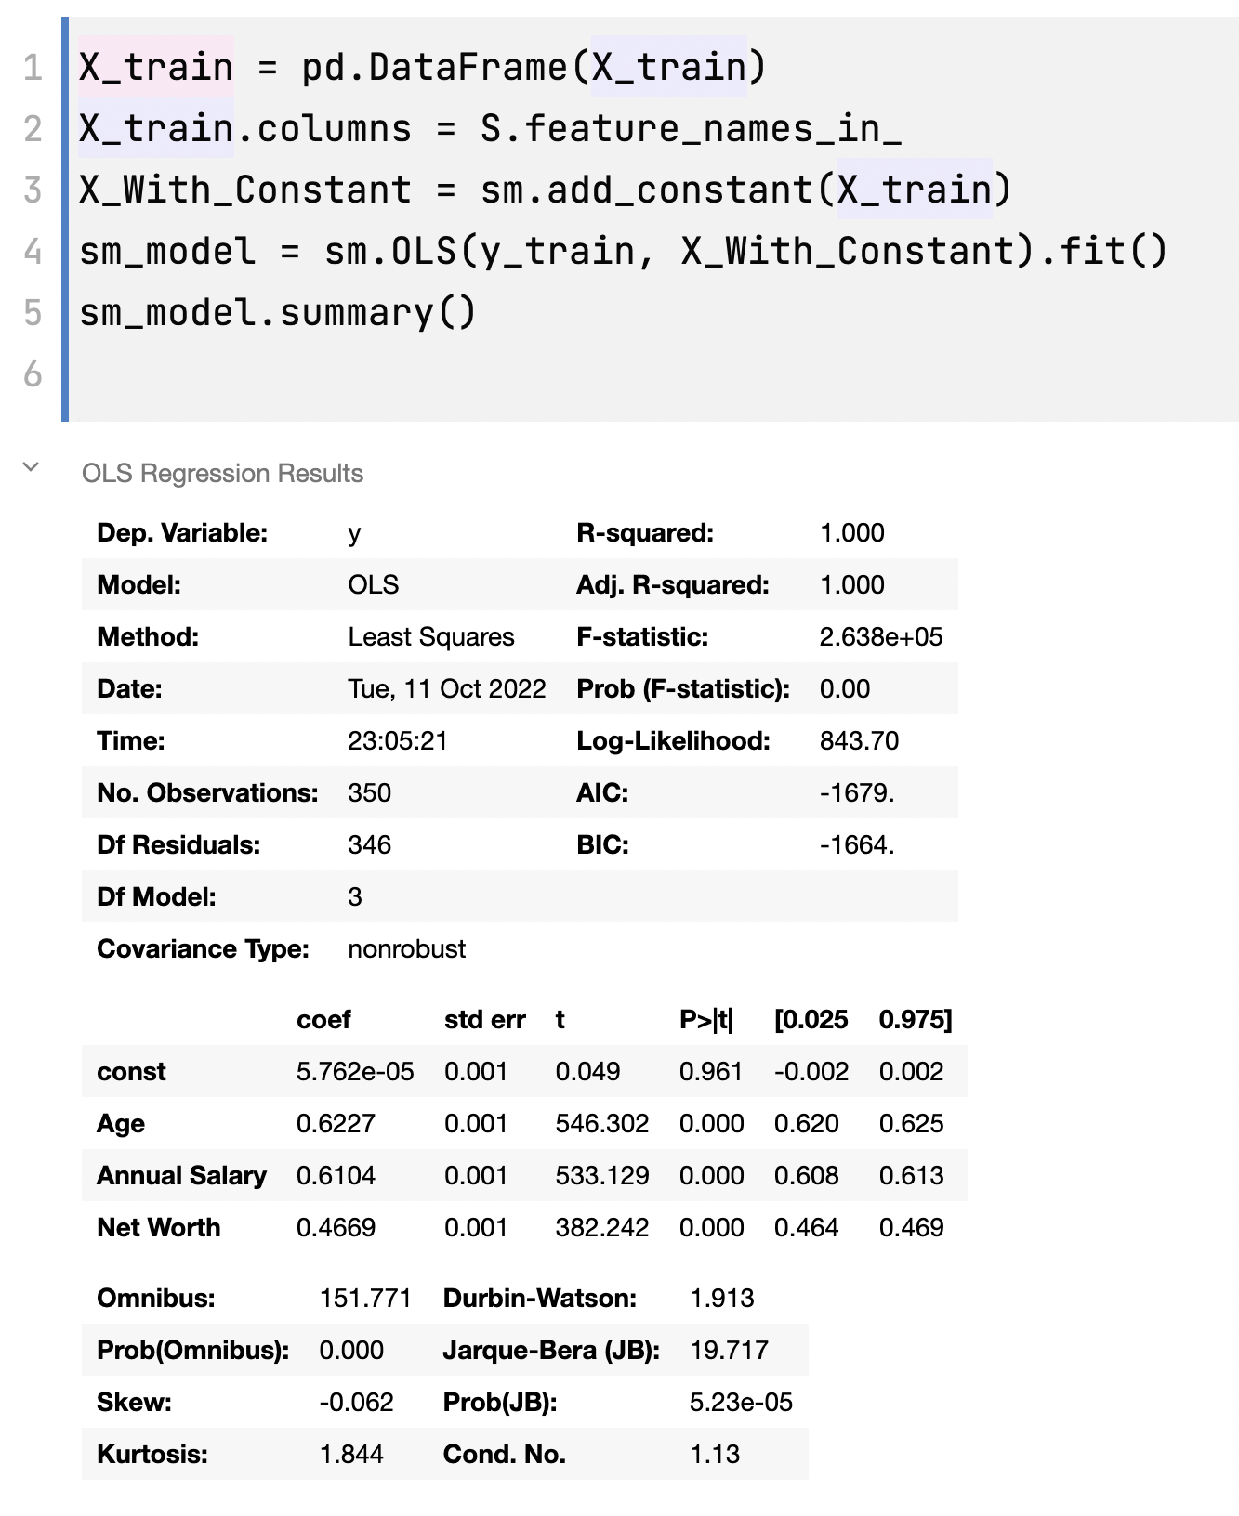
ANOVA TABLE
(Analysis of Variance)

Slide 22
Correlation of 3 linear features

Slide 23
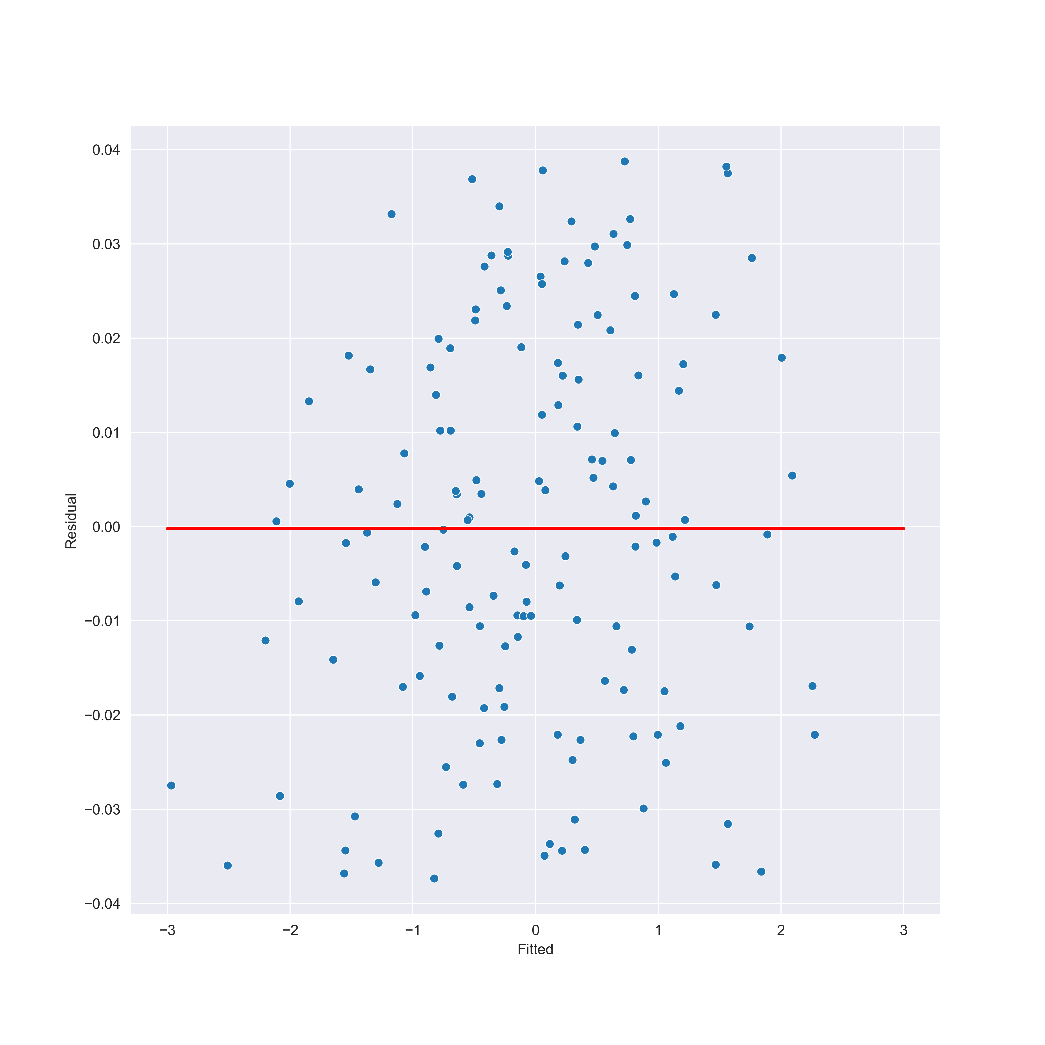
Residual vs Fitted

